Slide 1


Batteries Tester
Blanca Cano Camarero
Javier Germán Luzón Hidalgo
Miguel Romero García

Slide 2
Index
Week planning…………………………………3
Description and objectives……………………4
Week development…………………………….5
Actual state: direct taste……………………….6
Starting out with the Chiller……………………7
Temperature measurement with Multimeter…8

Slide 3
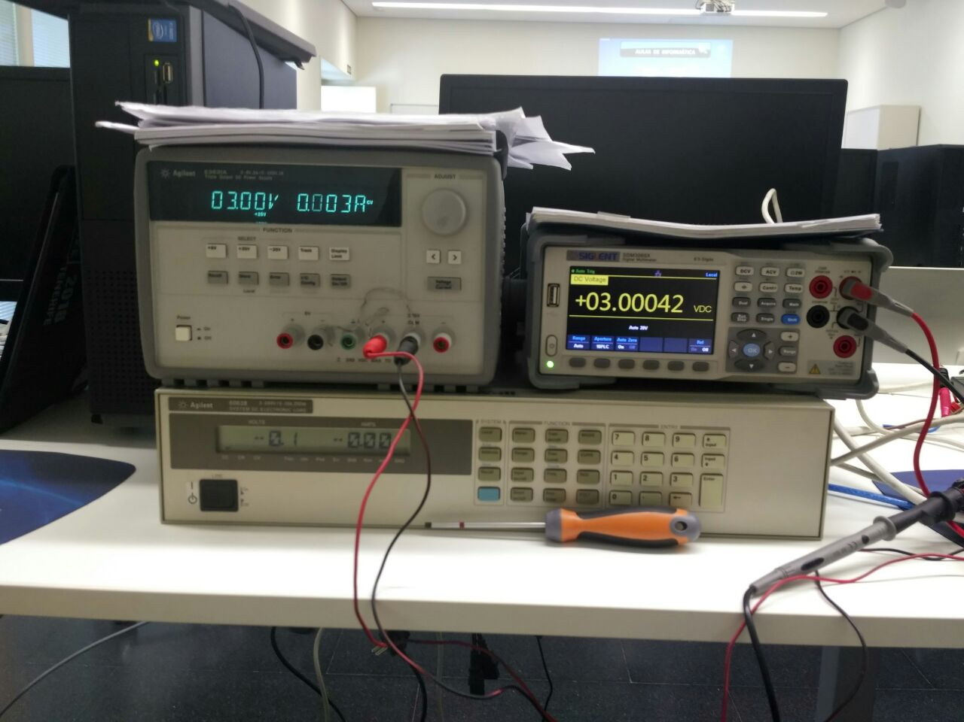
Week planning
1. Communicate equipment with computer
2. Create all the tests code
3. Try the test
Combine the functions of the Multimeter and the Chiller
Multimeter
Chiller
Temperature control
of the Chiller
with Multimeter

Slide 4
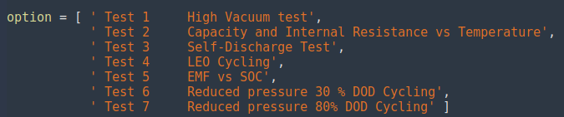

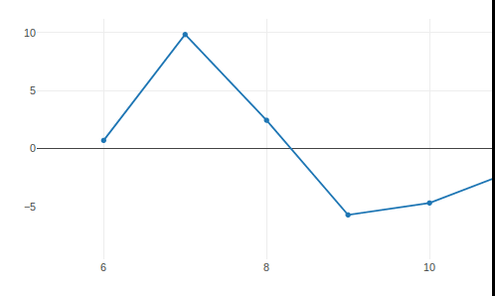

Description and objectives
1 Create an interface to choose the test
2 Obtain medition data
Turn on machine, charge, discharge, control temperature...
- Current
- Voltage
- Capacity
4 Save the results
3 View in real time
Save result in csv format.
comma-separated values
Three simultaneous graphs

Slide 5
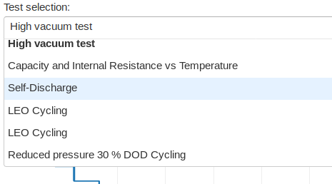
Week development
Monday
Tabs type
Problems:
Beta building library
Constraint design
Design interface
Dropdown
type
Final option
Tuesday
Wednesday
Solve library incompatibilities causes by Python virtual enviroment.
Start random value graph update
Finished random value graph.
Started imports unification, until that we had development, independently to reduce posibles error.
Interface
Main
Battery
Tester
Tests call
(random
simulation)
Thursday
Continued unification process
Data save
As an import

Slide 6
Actual state: direct taste
Steps
1. Open console
2. Execute main
3. Open web browser, with given direction
Requirements
pip install dash==0.21.1 # The core dash backend
pip install dash-renderer==0.13.0 # The dash front-end
pip install dash-html-components==0.11.0 # HTML components
pip install dash-core-components==0.23.0 # Supercharged components
pip install plotly --upgrade # Plotly graphing library used in examples
pip install pandas # pandas
pip install renderer
pip install render

Slide 7
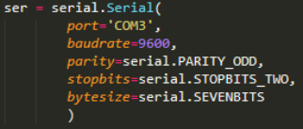
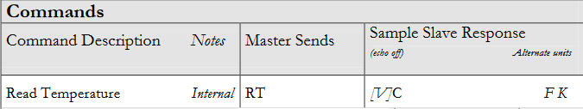
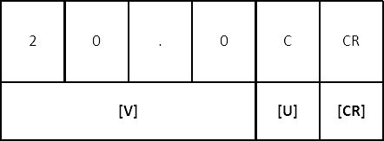
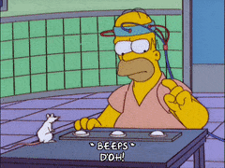
Starting out with the Chiller
Initial configuration
Select the serial port parameters for the communication.
Objective
Create a library in Python that includes all the commands available for the Chiller.
Obtaining the values of the readings to be able to work with them (p.e.: temperature values, settings values)
Problems
We have to test the serial communication with the Chiller in order to prove that the library is working.

Slide 8
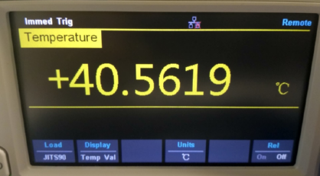

Temperature measurement with Multimeter
Thermocouple
Types
Electrical device consisting of two dissimilar conductors forming electrical junctions at differing temperatures
- BITS90
- EITS90
- JITS90
...
Create functions to set the sensor type used:
Thermoresistor
Type
A type of resistor whose resistance is dependent on temperature.
- PT100
IT WORKS!

Slide 9


preguntas
Any questions?

